Slide 1
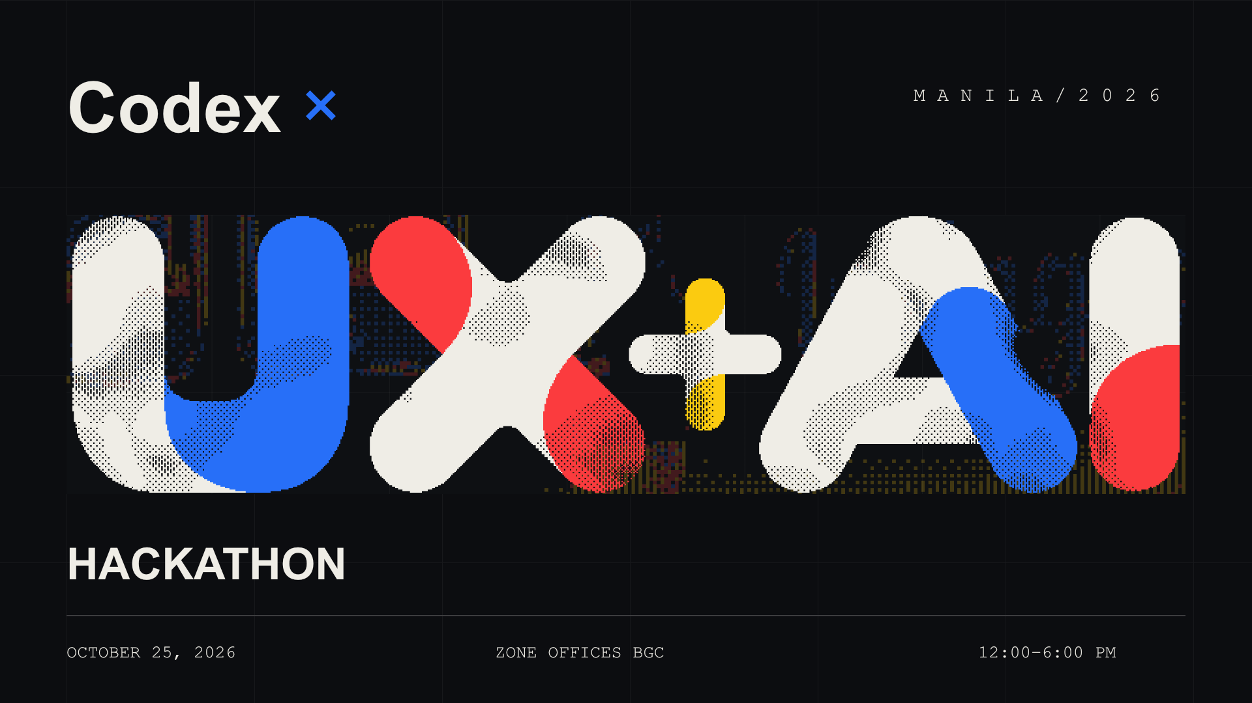

Slide 2

Today’s goal
A working prototype
for a real user
One clear problem. One core flow you can show.
Build with Codex, test the important path,
and make the experience easy to understand.

Slide 3
Agenda
12:00–12:25 pm | Check-in
12:25–12:40 pm | Welcome & build brief
12:40–3:25 pm | Build sprint
3:25–3:45 pm | Submissions
3:45–4:15 pm | Shortlisting & break
4:15–5:25 pm | Finalist demos & judging
5:25–5:45 pm | Awards
5:45–6:00 pm | Closing & group photo
Submissions close at 3:45 pm

Slide 4
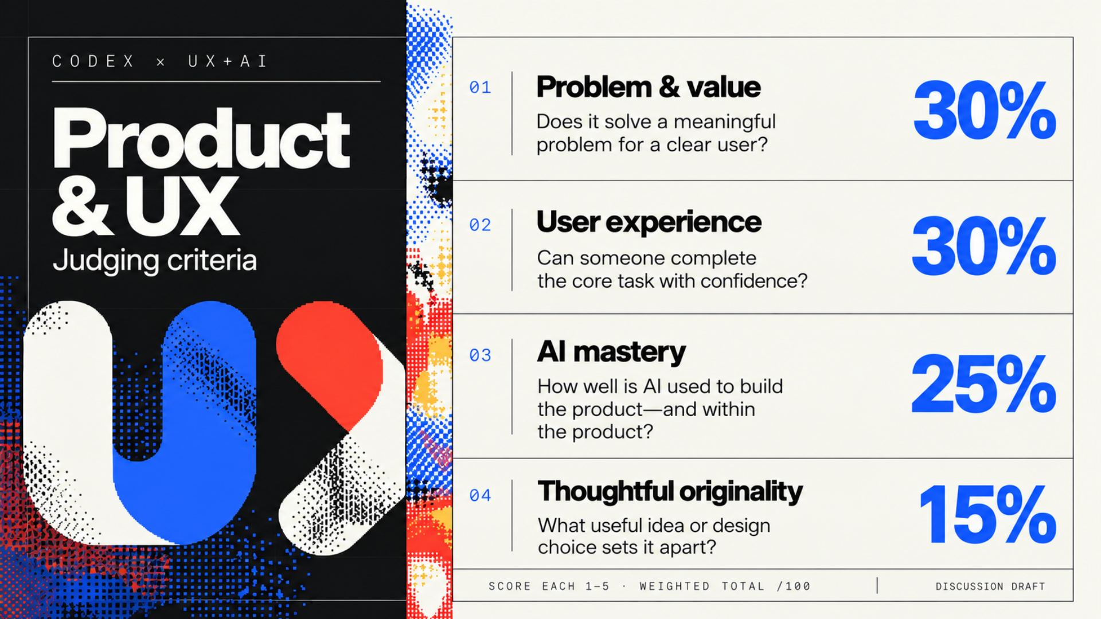

Slide 5
Prizes
USD 1,750
Total Codex credits
First place
Second place
Third place
$1,000
$500
$250
USD in Codex credits per winning team, not cash.

Slide 6
Participant credits
API credits
Codex credits
Separate credit types. Keep your codes private.
Follow the provided redemption instructions.
If you need help, ask an organizer.
One API credit + one Codex credit per participant

Slide 7
Submission checklist
01
Accessible prototype link
02
Who it helps and the problem it solves
03
What works and the current limitations
04
One concrete example of how you used Codex
Due 3:45 pm
Ask an organizer for the submission link.

Slide 8
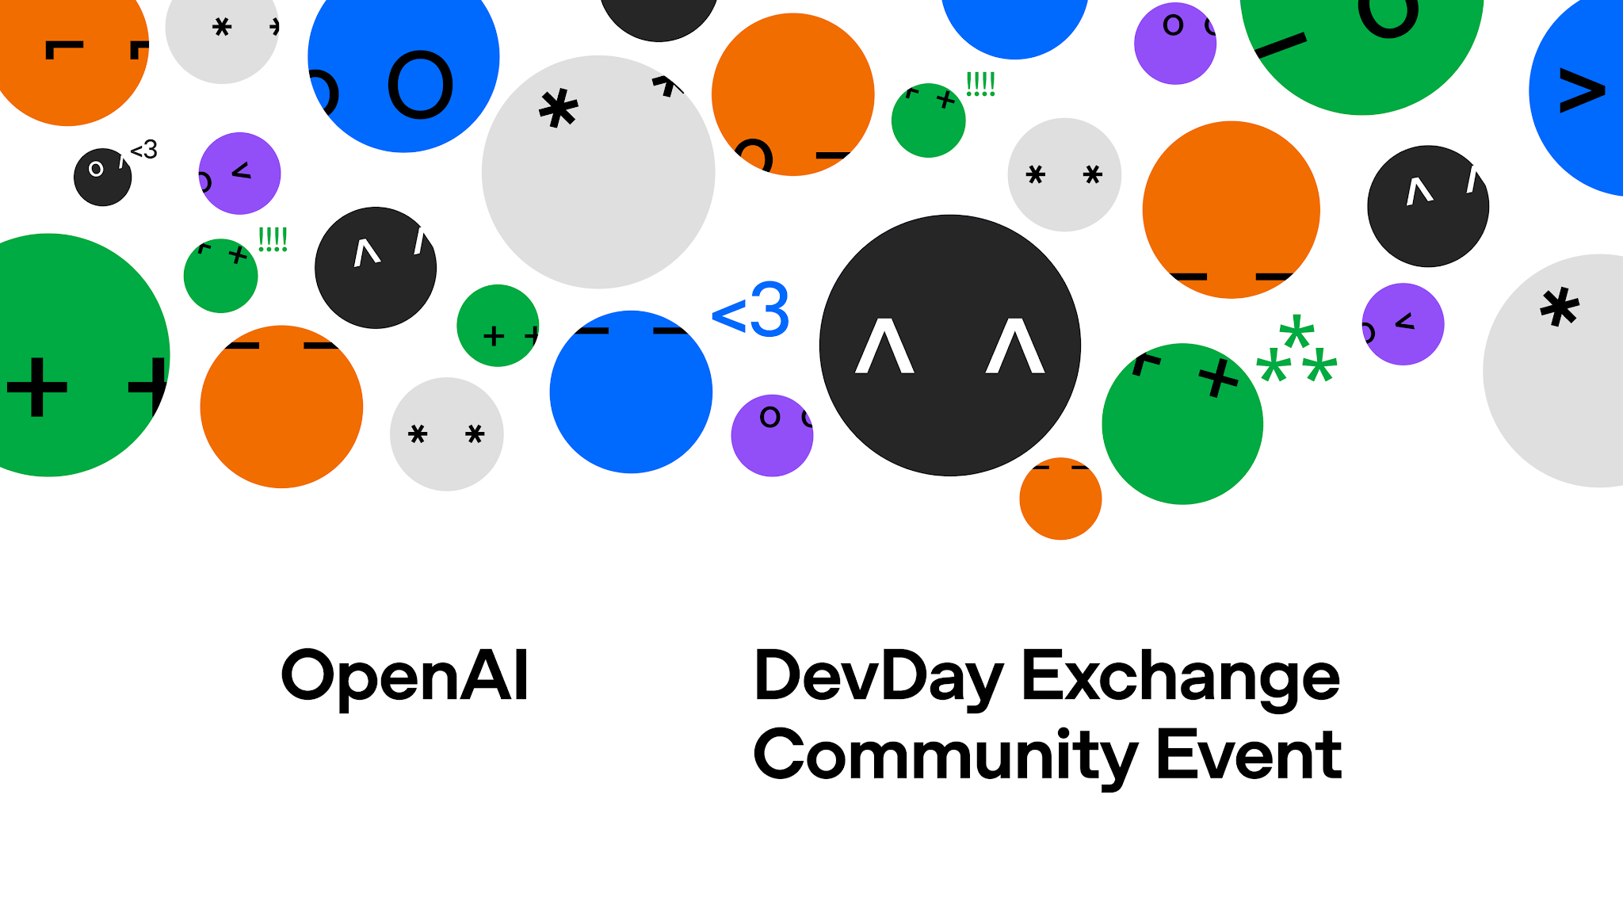
DevDay 2026 recap
Notes:
Community edition design source: https://drive.google.com/drive/folders/1c_E5e2poJFUAwO_c3BJvz4_YhaEAtUfy
Official Holding Screen and Social artwork used for this community recap.
DevDay 2026 announcements and updates. Availability checked 5 October 2026.
Visual reference: https://dotcom-design-engineering.openai.chatgpt.site/dev-day

Slide 9
More ways to build and work
Delegate ongoing work
Build and ship software
Agents that keep working across tools and tasks.
New models, cloud workflows, reviews, and security.
Bring your product into ChatGPT
Work together with AI
Plugins, interactive experiences, and connected Sites.
Shared knowledge, team tasks, and collaboration.
Notes:
More ways to build and work
Visual reference: https://dotcom-design-engineering.openai.chatgpt.site/dev-day

Slide 10

GPT-6.1 Sol
More capable work
within the same budget
Stronger coding, computer use, and professional work.
Near-Astra intelligence at one-fifth of Astra’s standard input and output token prices.
Available in Work, Codex, and the API
Notes:
GPT-6.1 Sol
Available through the API and in ChatGPT Work and Codex on eligible paid plans; it is not yet available in Chat. The price comparison is specifically against Astra’s standard input and output token prices.
Source: https://openai.com/index/introducing-gpt-6-1-sol/
Official launch image: https://openai.com/index/devday-2026-recap/

Slide 11
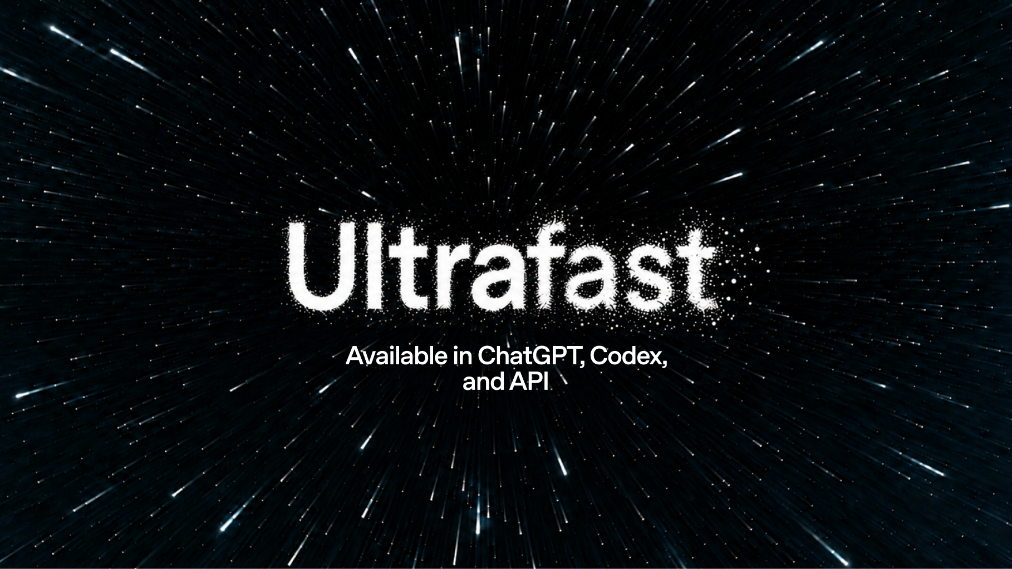
GPT-6 Astra Ultrafast
Less waiting between ideas
Up to 8×
faster token generation in Codex
Up to 6×
faster token generation in the API
Useful when iteration speed matters most.
Work + Codex: Pro 500 and eligible Enterprise/Edu • Sol Ultrafast coming soon
Notes:
GPT-6 Astra Ultrafast
Generation speed is distinct from total task time. Enterprise access requires workspace enablement and eligible billing; the API is available separately.
Sources: https://learn.chatgpt.com/docs/agent-configuration/speed
https://developers.openai.com/api/docs/guides/ultrafast-mode
https://openai.com/index/introducing-gpt-6-1-sol/
https://openai.com/index/devday-2026-recap/
Official launch image: https://openai.com/index/devday-2026-recap/

Slide 12

Dots
Delegate ongoing
responsibilities
Always-on agents that learn what matters to you and work on your behalf.
Keep ongoing work moving while you focus elsewhere.
Pro and Business Premium in eligible markets • Enterprise, Edu, Healthcare: admin-enabled beta
Notes:
Dots
A dot can work across connected apps with permissions you control. Give it a recurring responsibility, define the boundaries, and review consequential work.
Source: https://openai.com/index/introducing-dots/
Official launch image: https://openai.com/index/devday-2026-recap/

Slide 13
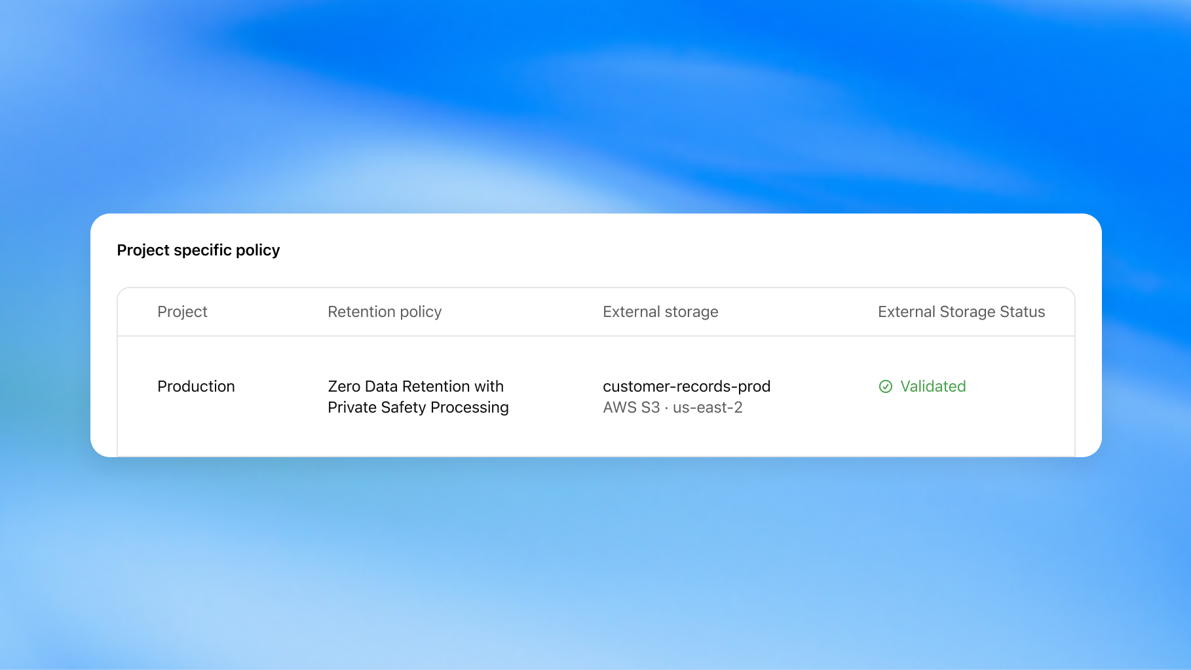
Private Intelligence
More control over
sensitive AI workloads
Private Safety Processing
Automated safety reviews without personnel accessing underlying content.
Private Inference
Confidential computing with verifiable controls; preview planned for fall 2026.
Evaluate frontier AI for workloads with stronger privacy requirements.
Notes:
Private Intelligence
Private Safety Processing is available to eligible Zero Data Retention organizations after setup. Private Inference is a separate upcoming preview.
Sources: https://developers.openai.com/api/docs/guides/private-safety-processing
https://openai.com/index/devday-2026-recap/
Official launch image: https://openai.com/index/devday-2026-recap/

Slide 14
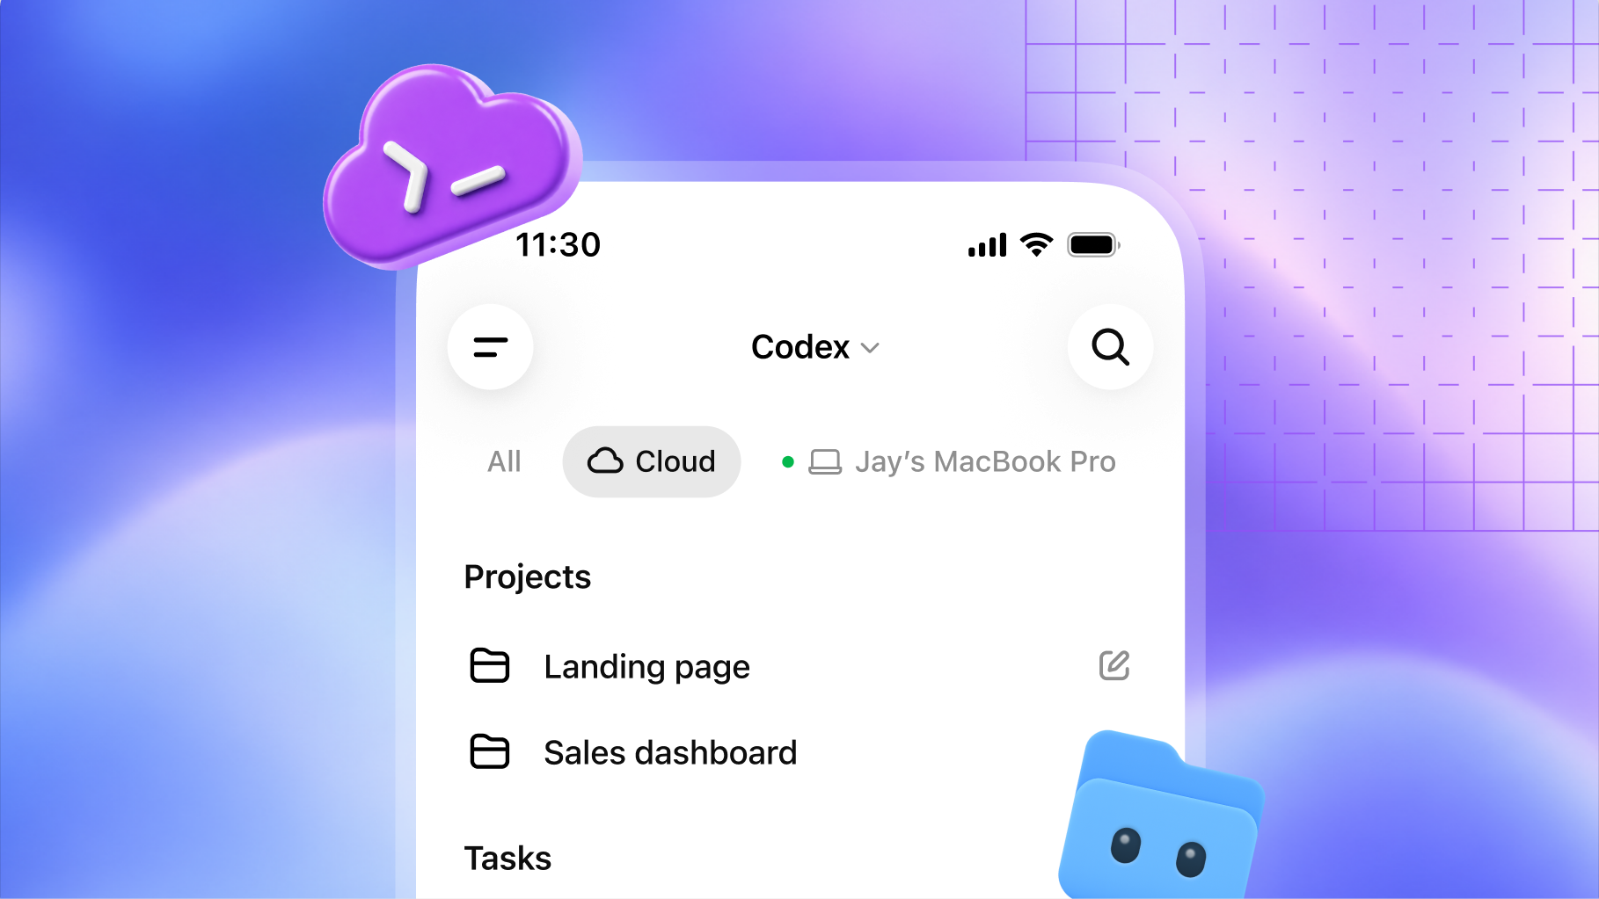
Codex in the cloud
Your development environment,
ready wherever you are
Run tasks in the cloud and steer work from another device.
Reusable environments give teams a consistent setup, settings, and permissions.
Work from web, desktop, or mobile
Notes:
Codex in the cloud
Create and publish an environment with the repositories, tools, and access a project needs. Each task has its own workspace and can continue while your computer sleeps.
Source: https://learn.chatgpt.com/docs/cloud
Official launch image: https://openai.com/index/devday-2026-recap/

Slide 15
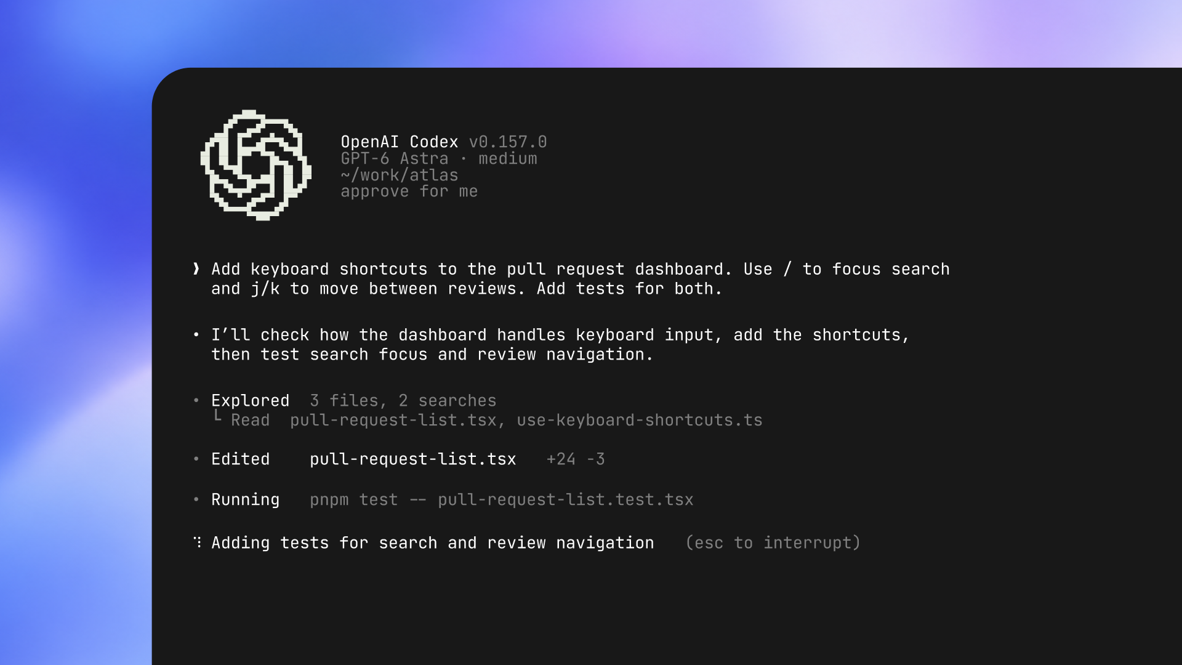
A refreshed Codex CLI
More control in the terminal
Speak
Start and steer tasks with your voice.
Delegate
Use /agents to follow delegated work.
Resume
Return to sessions and worktrees.
Keep complex coding sessions easier to manage.
Available in the Codex CLI
Notes:
A refreshed Codex CLI
The terminal workflow supports exploring a repository, editing files, and running local development tools in one session.
Sources: https://learn.chatgpt.com/docs/codex/cli
https://openai.com/index/devday-2026-recap/
Official launch image: https://openai.com/index/devday-2026-recap/

Slide 16
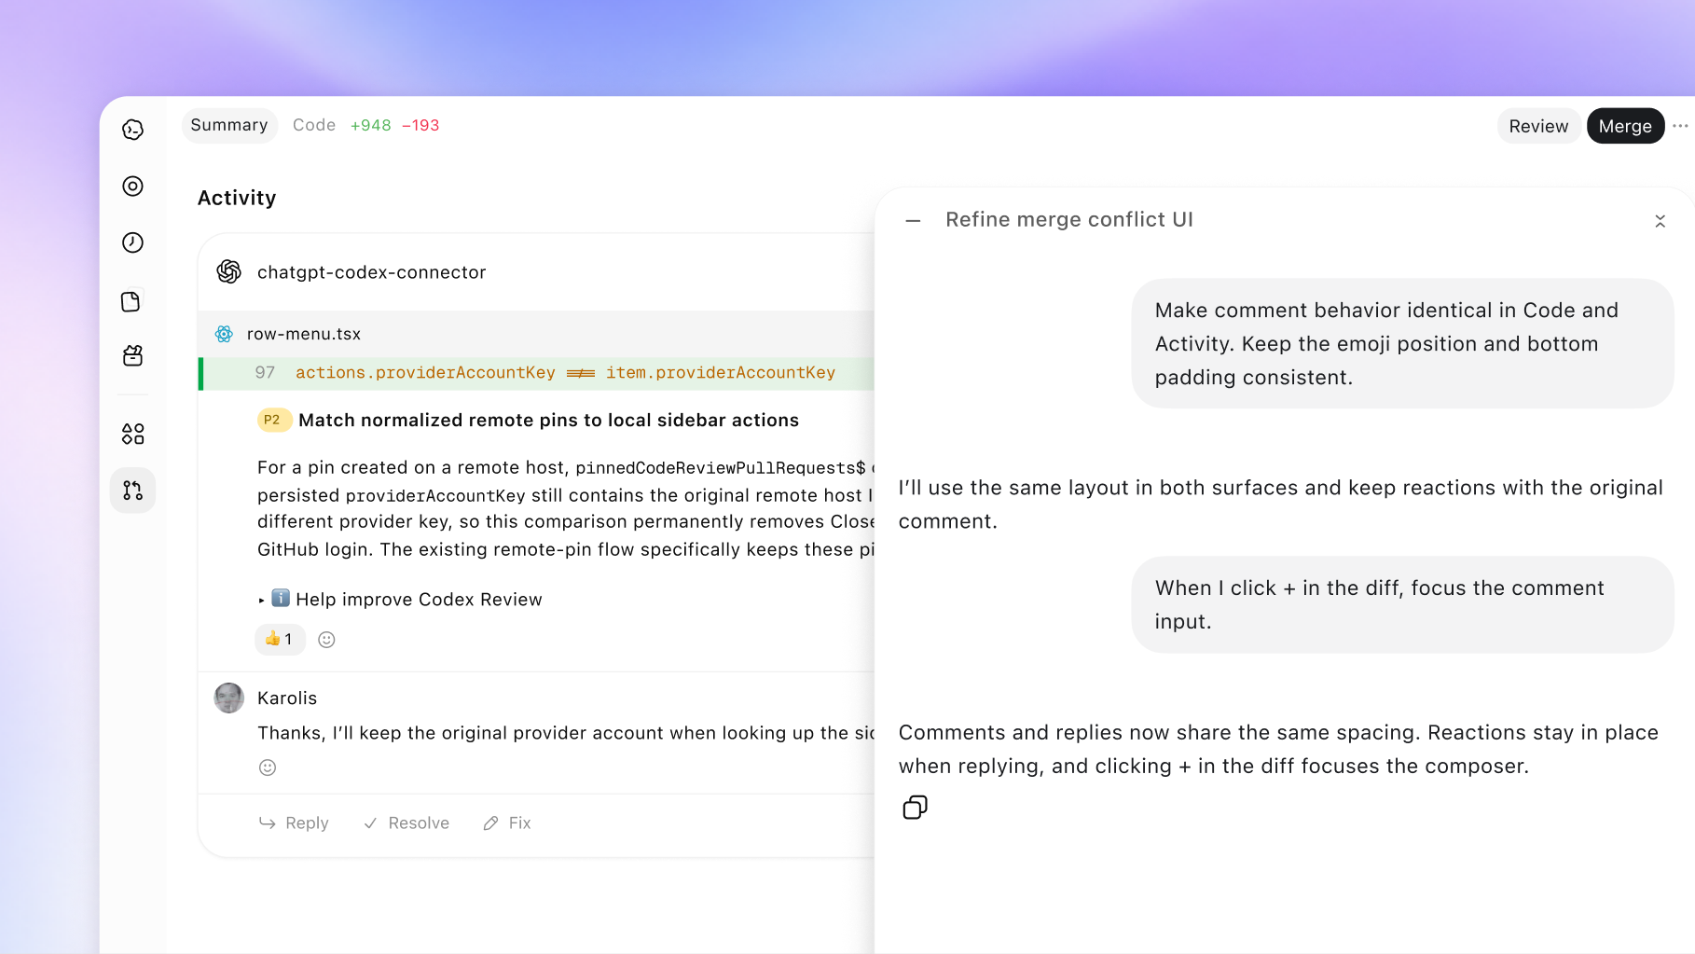
Code Review
Understand the change
before you merge it
Read summaries, inspect diffs, and ask Codex about potential issues across projects.
Automatic cloud reviews can take a first pass while you’re away.
GitHub available; GitLab merge requests in preview
Notes:
Code Review
The desktop review experience brings a pull request’s context and changes together. Automatic cloud reviews require a connected repository and enabled review settings; the reviewer still evaluates the findings.
Source: https://learn.chatgpt.com/docs/code-review?surface=app
Official launch image: https://openai.com/index/devday-2026-recap/

Slide 17
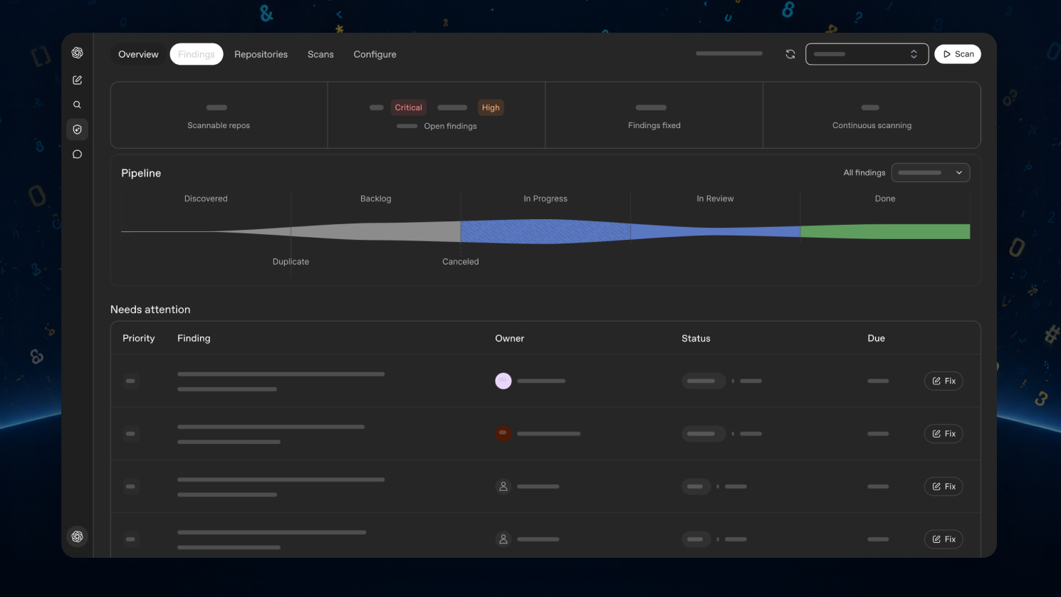
Codex Security Cloud
Keep checking your code
after the laptop closes
Scan GitHub repositories, investigate findings, and prepare proposed fixes in the cloud.
Check the repository now and monitor new commits over time.
Cloud scans • Web and desktop
Notes:
Includes access to models offered through Daybreak Blue without a separate Daybreak application.
Source: https://openai.com/index/devday-2026-recap/
Codex Security Cloud
Review the affected code, validation evidence, and remediation guidance. When a fix is available, review the proposed patch before opening a draft pull request.
Source: https://learn.chatgpt.com/docs/security/setup
Official launch image: https://openai.com/index/devday-2026-recap/

Slide 18
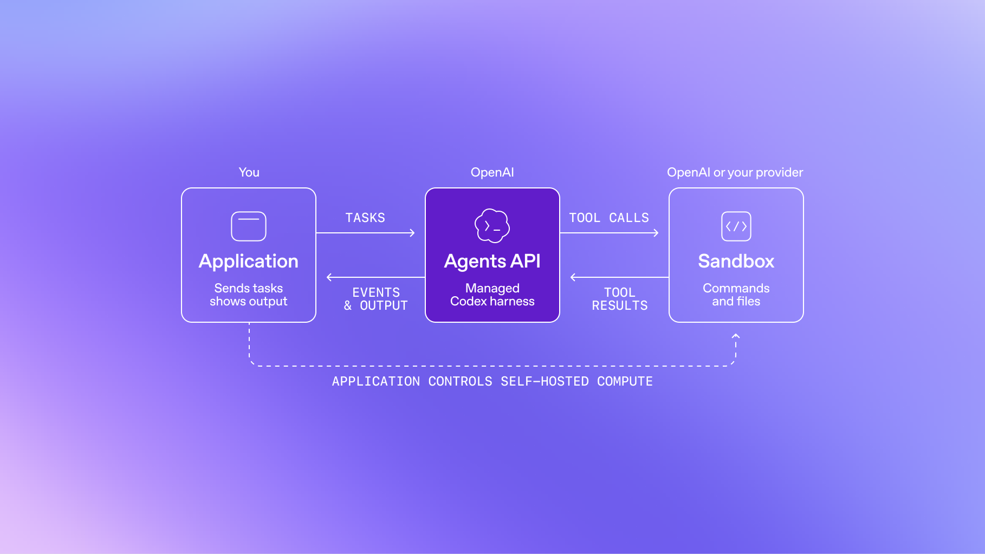
Agents API with computer use
Build agents that can
use browser interfaces
Computer use joins delegation, tools, tool search, and context management.
OpenAI runs the underlying agent infrastructure so you can focus on your application.
Agents API: public beta
Notes:
Agents API with computer use
Computer use is the DevDay update to the Agents API, which launched earlier in September. The API runs a browser in an OpenAI-hosted environment; your application handles access approvals and follows the work.
Sources: https://developers.openai.com/api/docs/guides/agents-api/tools/computer-use
https://openai.com/index/introducing-the-agents-api/
Official launch image: https://openai.com/index/devday-2026-recap/

Slide 19
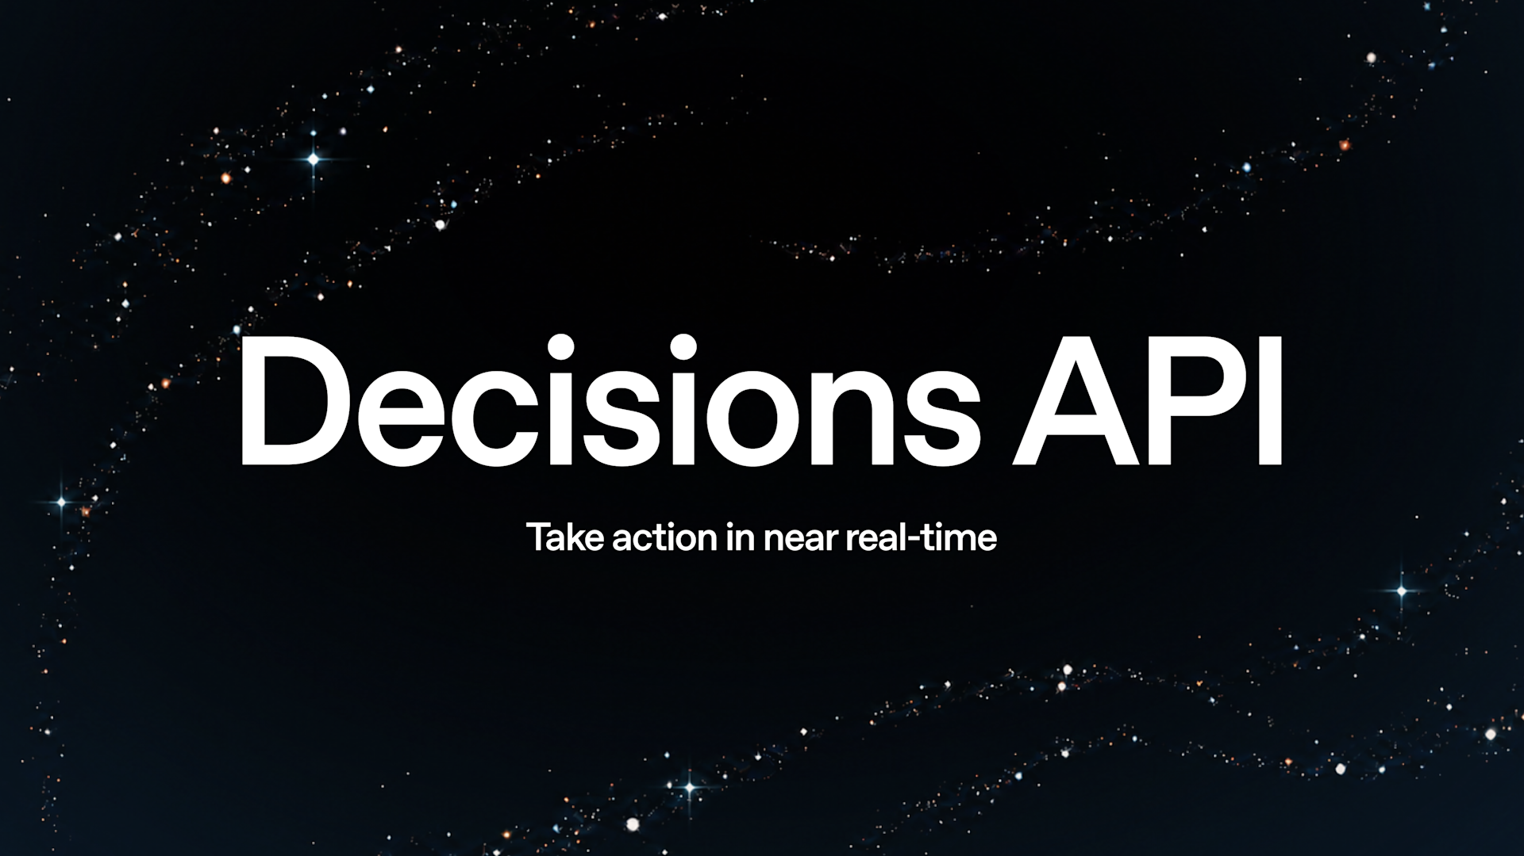
Decisions API
Turn context into
a specific next action
You define the choices
Provide text or images and a finite set of possible answers.
Luna returns a decision
Classify content, route a request, or choose an agent’s next step.
Announced in limited preview; broader release planned
Notes:
Decisions API
Define the answer space before calling the model so the result fits a routing or classification workflow.
Source: https://openai.com/index/devday-2026-recap/
Official launch image: https://openai.com/index/devday-2026-recap/

Slide 20

Bedrock Managed Agents
OpenAI agents,
running in AWS
OpenAI models and the Codex harness, integrated with Amazon Bedrock AgentCore.
Build where your applications and data already run.
Preview • Powered by OpenAI
Notes:
Bedrock Managed Agents
The agent runtime and model inference remain inside AWS, with AWS identities and permissions. This offering is in preview.
Source: https://aws.amazon.com/bedrock/managed-agents-openai/
Official launch image: https://openai.com/index/devday-2026-recap/

Slide 21
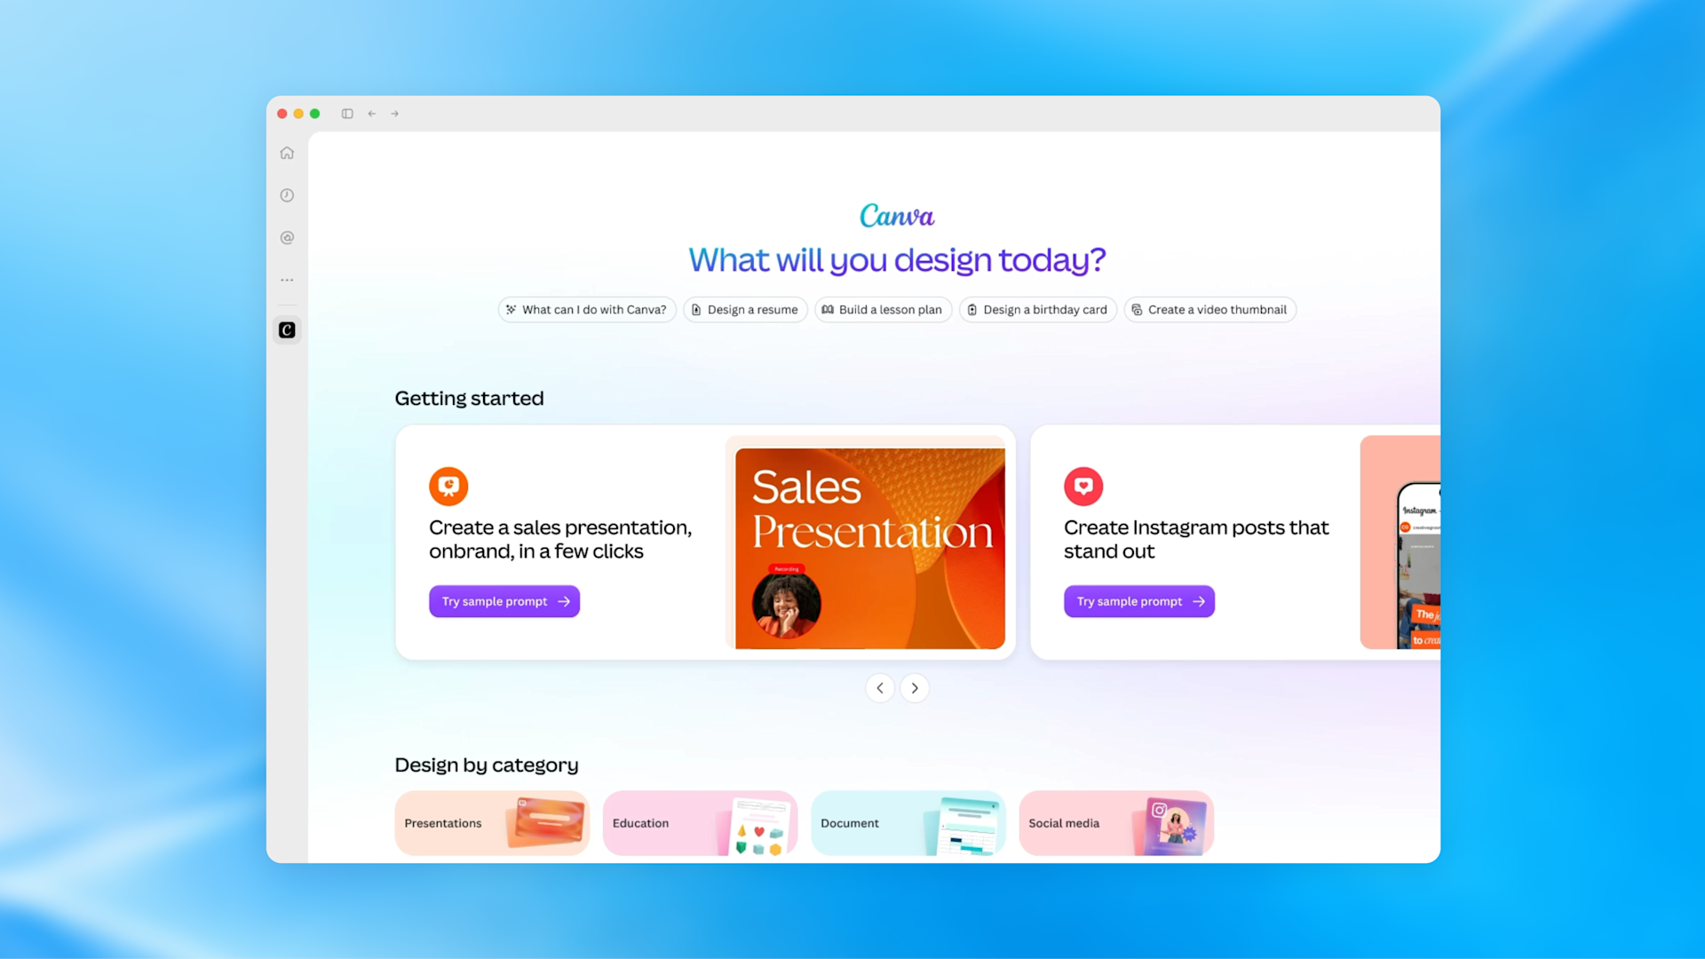
Plugin extensions
Give your product
a home inside ChatGPT
Sidebar entry
A dedicated starting point for your plugin.
Interactive panels
A workspace beside the conversation.
File viewers
Open the file types your product supports.
Let people use your experience where they already work with AI.
Free and Go web support coming soon
Notes:
Plugin extensions
Extensions include sidebar entry points, conversation panels, file viewers and editors, and more. Composer mentions are currently available only in the desktop app.
Source: https://developers.openai.com/plugins/build/extensions
Official launch image: https://openai.com/index/devday-2026-recap/

Slide 22
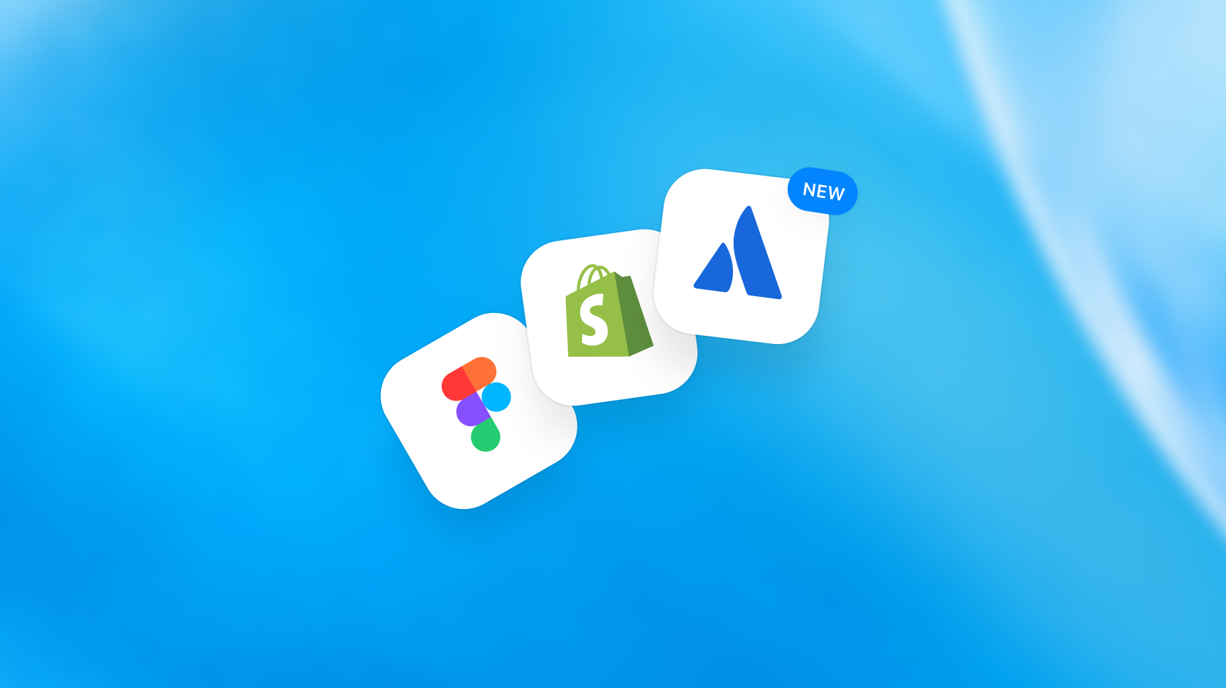
Build and discover plugins
A clearer path from
idea to discovery
Create
Plugin Creator helps assemble your plugin.
Submit
A redesigned flow gives clearer feedback.
Discover
Help people find your plugin.
Users choose their plugins and approve the access each receives.
Notes:
Build and discover plugins
Plugin Creator can help prepare the package. Automated checks identify issues before review, and approved developers choose when to publish.
Sources: https://developers.openai.com/plugins/deploy/submission
https://openai.com/index/devday-2026-recap/
Official launch image: https://openai.com/index/devday-2026-recap/

Slide 23
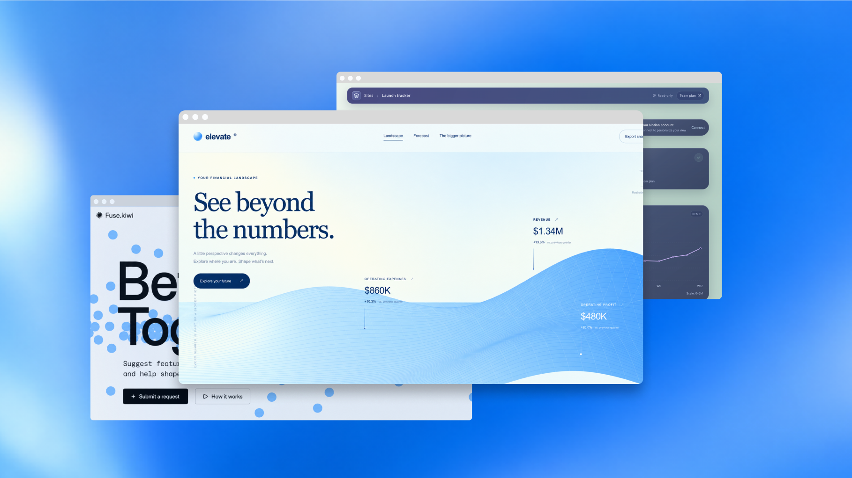
Sites with connected plugins
Build a shared app
with each person’s own data
Add supported plugins to Sites. Teammates connect their own accounts and permissions.
Create shared tools without giving everyone the same data access.
Business, Enterprise, Healthcare, and Edu • Connected tools currently read-only
Notes:
Sites also makes automations easier to add and manage, helping keep shared information current.
Source: https://openai.com/index/devday-2026-recap/
Sites with connected plugins
A shared dashboard can read information that each visitor has approved and is already allowed to access. Connected-tool access is currently read-only.
Source: https://chatgpt.com/features/sites/
Official launch image: https://openai.com/index/devday-2026-recap/

Slide 24
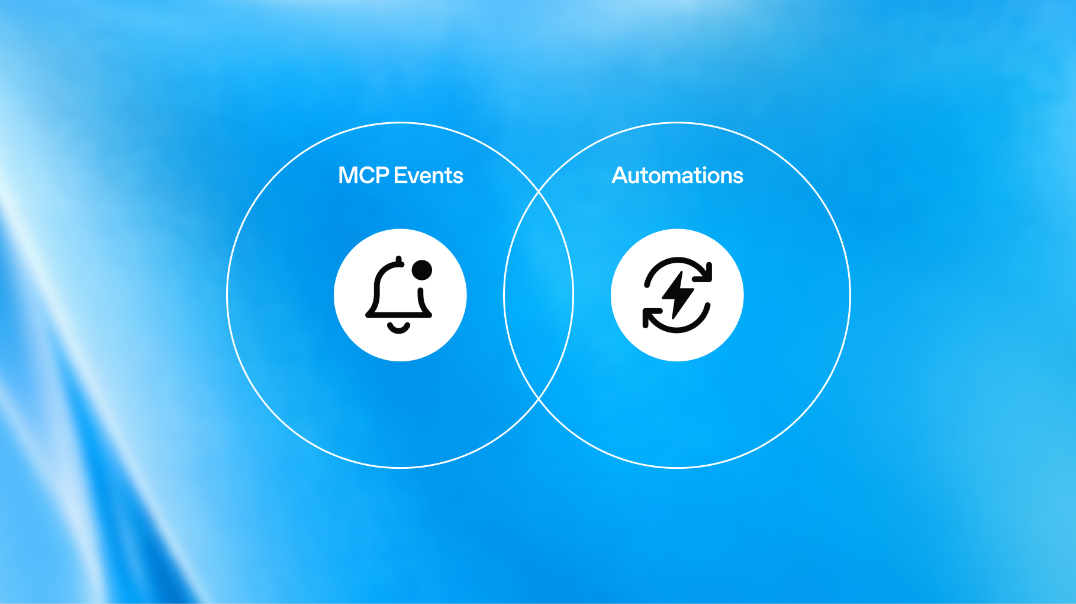
MCP events
Start work when
something happens
Plugin events can trigger automations when connected apps change.
New messages or document comments can trigger the workflow you define.
Work on web, cloud Work on desktop, and dots
Notes:
MCP events
Users choose the event and the response. The integration supports webhook delivery from the draft MCP Events specification, subject to workspace controls.
Source: https://developers.openai.com/plugins/build/mcp-events
Official launch image: https://openai.com/index/devday-2026-recap/

Slide 25
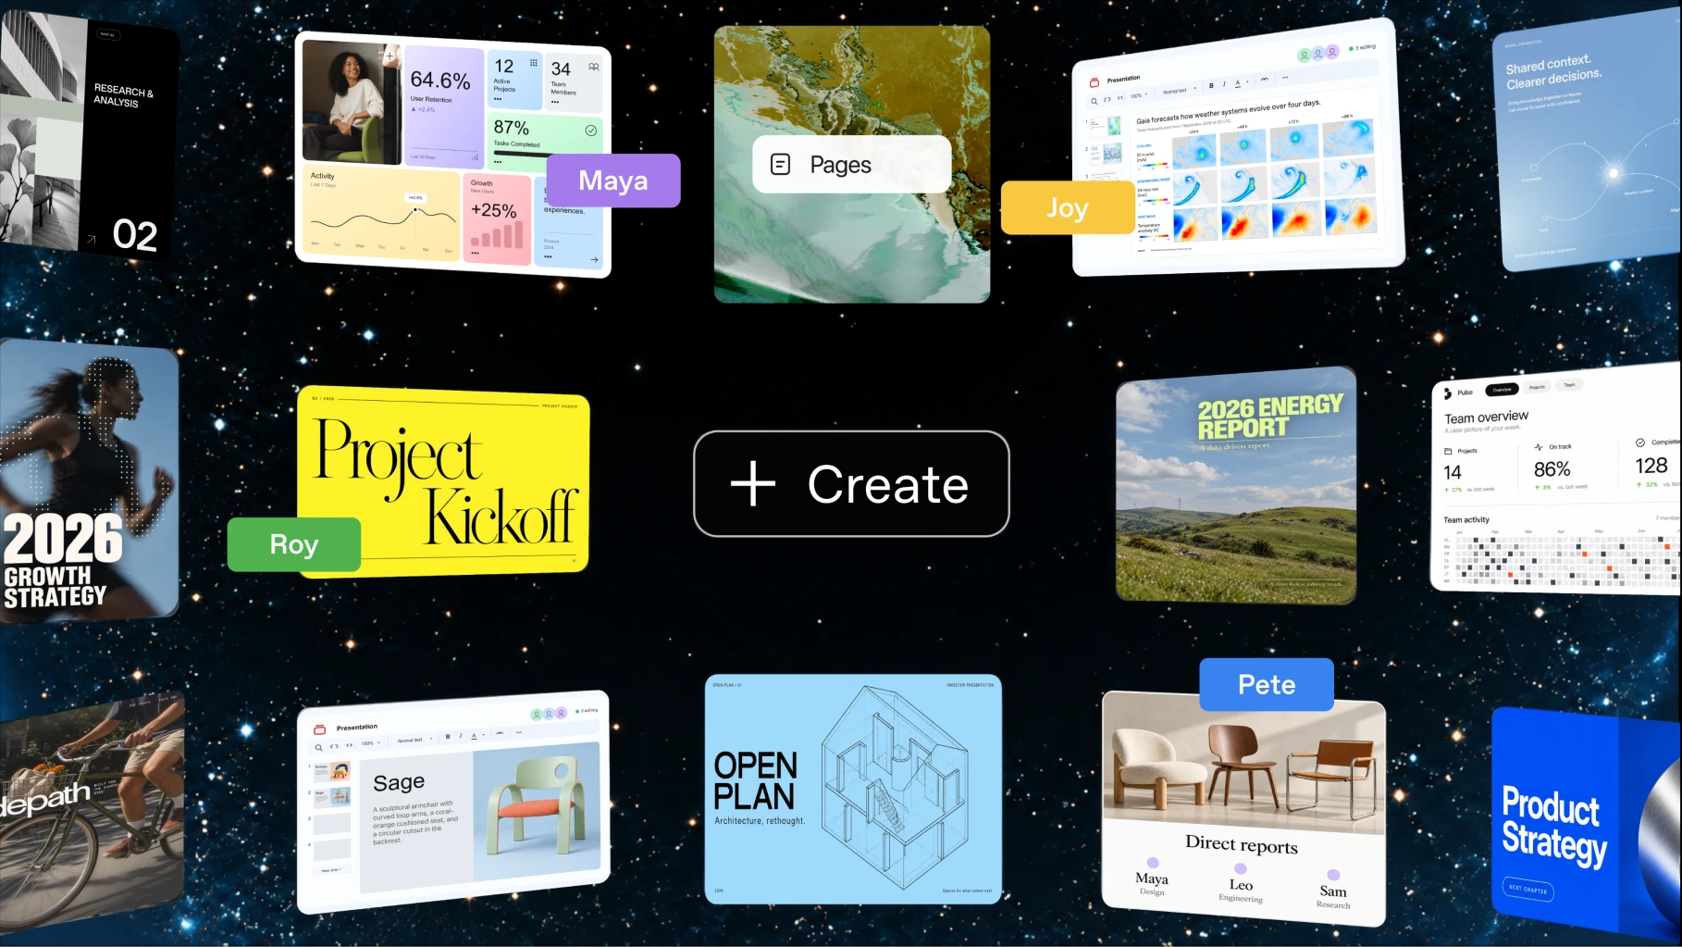
ChatGPT Space
A shared home for
your team’s work with AI
Bring teammates, ChatGPT, and your dot together around shared knowledge.
Keep work organized and easier to pick up again.
Pro, Business, and Enterprise • Web and desktop
Notes:
ChatGPT Space
Group pages around a topic or team and connect supporting sources. People can find, read, and share on mobile; mobile editing and collaboration are coming soon.
Sources: https://learn.chatgpt.com/docs/space
https://chatgpt.com/features/space/
Official launch image: https://openai.com/index/devday-2026-recap/

Slide 26
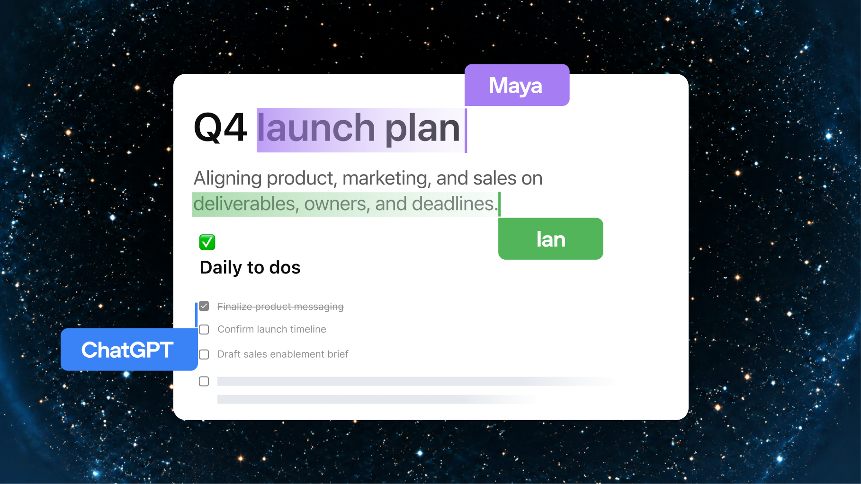
Pages
Work on the same
living document
Write, research, create charts and images, and visualize information with AI on a page.
Invite teammates to contribute ideas and feedback in one place.
Pro, Business, and Enterprise
Notes:
Pages
A page can combine text, tables, images, source material, and interactive tools. Edit directly, ask ChatGPT for revisions, or leave feedback for collaborators.
Source: https://learn.chatgpt.com/docs/space/pages
Official launch image: https://openai.com/index/devday-2026-recap/

Slide 27
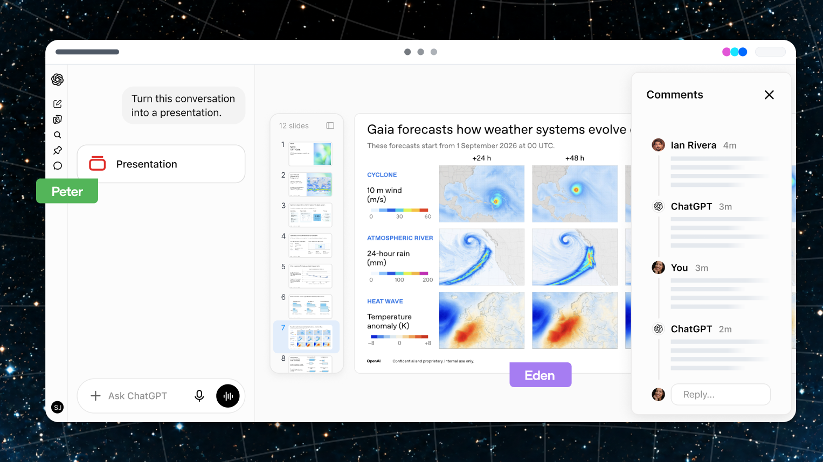
Collaborative slides
Build a deck together
with people and agents
Create from a conversation or a template. Edit and comment together.
Present in ChatGPT or export to PowerPoint and Google Slides.
Coming soon • Pro, Business, and Enterprise
Notes:
Collaborative slides
The public Space page still marks collaborative slides as coming soon.
Sources: https://chatgpt.com/features/space/
https://openai.com/index/devday-2026-recap/
Official launch image: https://openai.com/index/devday-2026-recap/

Slide 28
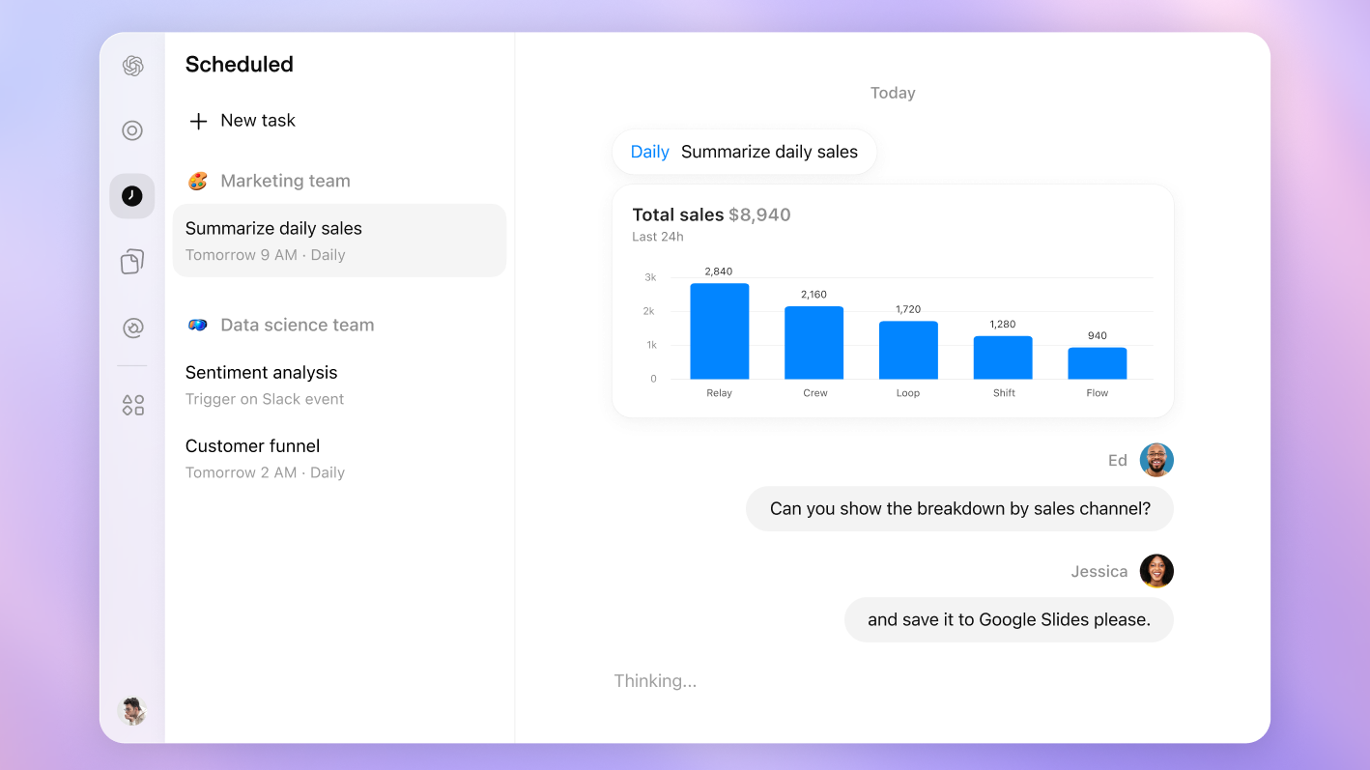
Teams and shared tasks
Make recurring work
a team workflow
Share pages, plugins, slides, and spreadsheets with your team.
Set up recurring tasks and refine their instructions together as priorities change.
Business and Enterprise
Notes:
Teams and shared tasks
Team Tasks can run on a schedule or when an event occurs, using the team’s configured connections. Workspace permissions govern who can create teams and manage their tasks.
Source: https://learn.chatgpt.com/docs/enterprise/teams
Official launch image: https://openai.com/index/devday-2026-recap/

Slide 29
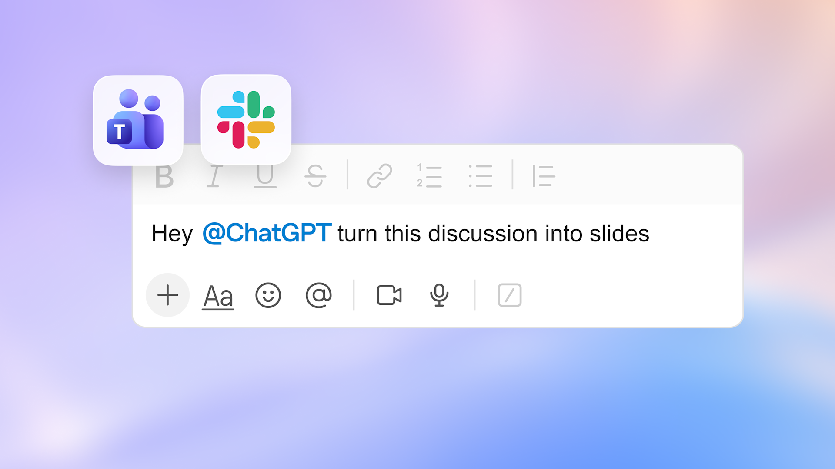
@ChatGPT in Slack and Teams
Bring AI into
the team conversation
Mention ChatGPT in a channel, thread, or direct message to work with connected tools.
Teammates can add context and improve results in the same conversation.
Business, Enterprise, and Edu • Admin setup required
Notes:
@ChatGPT in Slack and Teams
People in enabled channels can participate without an individual ChatGPT license. ChatGPT uses configured connections and approved access; it does not automatically inherit personal accounts or full channel history.
Source: https://chatgpt.com/features/chatgpt-in-slack-and-teams/
Official launch image: https://openai.com/index/devday-2026-recap/

Slide 30
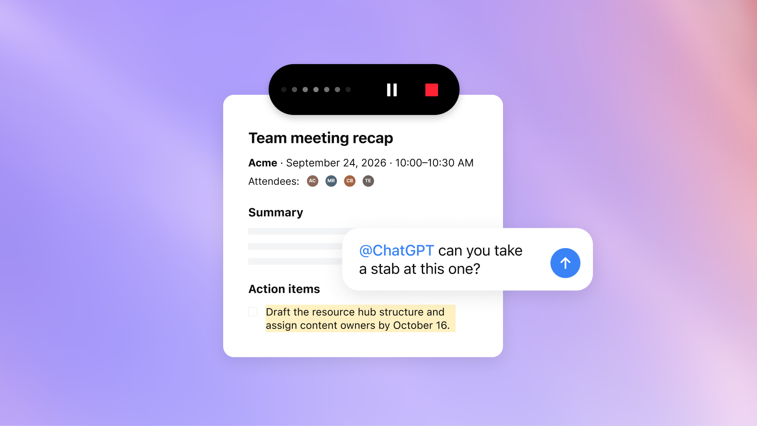
Meetings plugin
Keep the decisions
and the next steps
Capture notes and personalized summaries with action items in ChatGPT Space.
Use the notes to update a plan or draft a follow-up. Audio is deleted after notes are ready.
macOS beta: Pro and Business • Enterprise: limited alpha
Notes:
Meetings plugin
Use it for online calls or in-person conversations without a bot joining. Get participants’ consent before starting the notes.
Source: https://help.openai.com/en/articles/20001546-the-meetings-plugin-in-chatgpt
Official launch image: https://openai.com/index/devday-2026-recap/

Slide 31
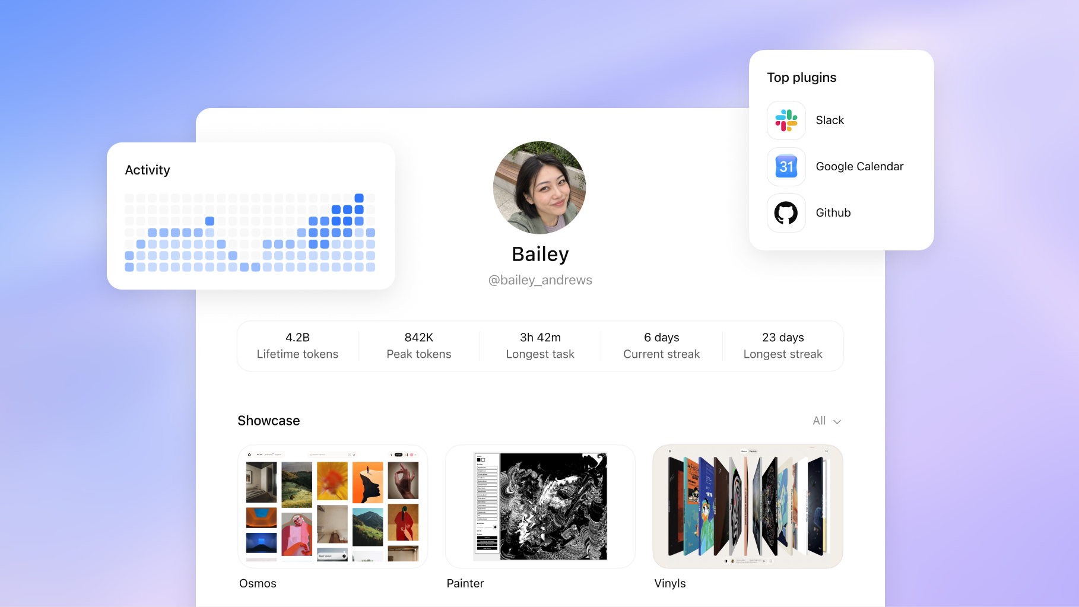
Shareable profiles
Make your work
easier to find and reuse
Bring your Sites and activity together in a profile you can share.
Help others discover the Sites you’ve built.
Web and desktop • Enterprise support coming soon
Notes:
Teammates can also discover shared skills; skills sharing is limited to the workspace.
Source: https://openai.com/index/devday-2026-recap/
Shareable profiles
Choose which Sites to showcase and how to share your personal profile. Business profile visibility follows workspace controls; showcasing a Site does not change its permissions.
Source: https://help.openai.com/en/articles/20001539-shareable-profiles-in-chatgpt
Official launch image: https://openai.com/index/devday-2026-recap/

Slide 32
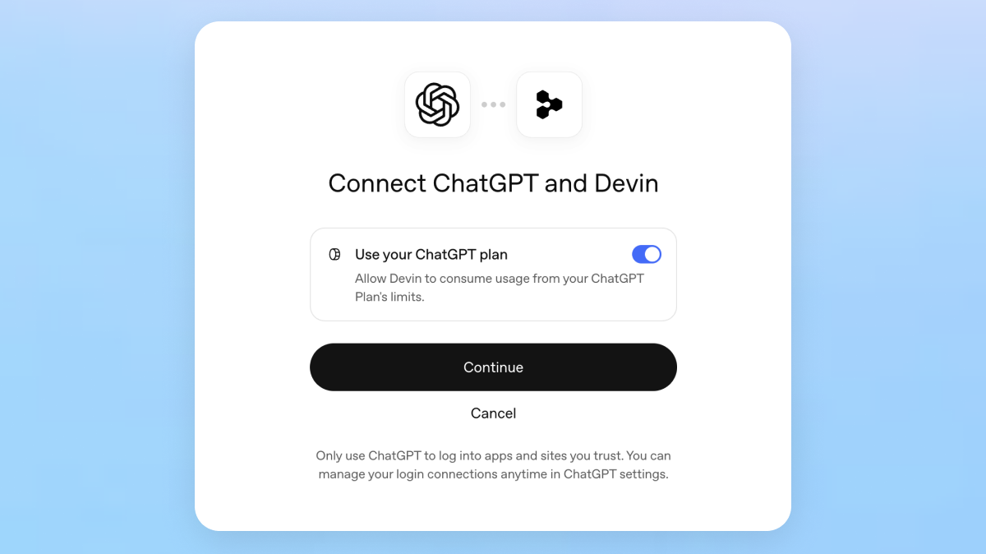
Sign in with ChatGPT
Use your plan
across more tools
Connect participating tools with your ChatGPT account and control how much allowance each can use.
Fewer separate sign-ins, with eligible OpenAI usage counted against your plan.
Plan usage: Plus and Pro in participating apps
Notes:
Sign in with ChatGPT
Set a weekly cap for each participating app. This draws on existing Work and Codex usage; the partner may still charge separately for its own subscription or services.
Source: https://help.openai.com/en/articles/20001542-using-your-chatgpt-plan-in-other-apps-and-sites
Official launch image: https://openai.com/index/devday-2026-recap/

Slide 33

Pro 500
More room for demanding work
25×
the ChatGPT Plus usage allowance
Ultrafast
access to the premium speed tier
A new Pro tier for people who need more usage and speed.
Available now • $500/month
Notes:
Pro 500
Pro 500 includes Astra Ultrafast and the highest included allowance among Pro plans. Existing plan limits still apply.
Sources: https://help.openai.com/en/articles/9793128-about-chatgpt-pro-tiers
https://openai.com/index/devday-2026-recap/
Official launch image: https://openai.com/index/devday-2026-recap/

Slide 34
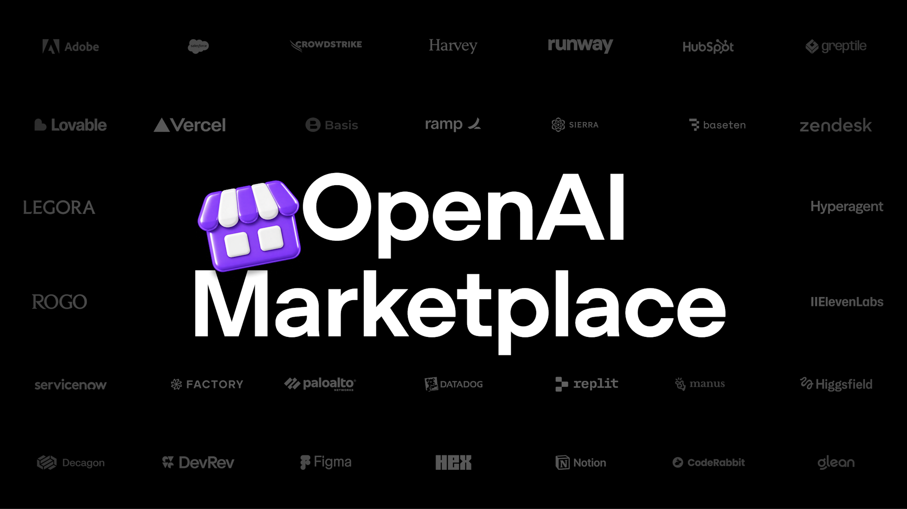
OpenAI Marketplace
Use your commitment
across partner software
Eligible enterprises can apply part of an existing OpenAI commitment to approved partners.
Choose tools for design, customer experience, legal work, and security.
Enterprise customers can express interest
Notes:
OpenAI Marketplace
This is a procurement option for eligible enterprise commitments and partner products. It is separate from the ChatGPT plugin directory.
Source: https://openai.com/business/marketplace/
Official launch image: https://openai.com/index/devday-2026-recap/

Slide 35
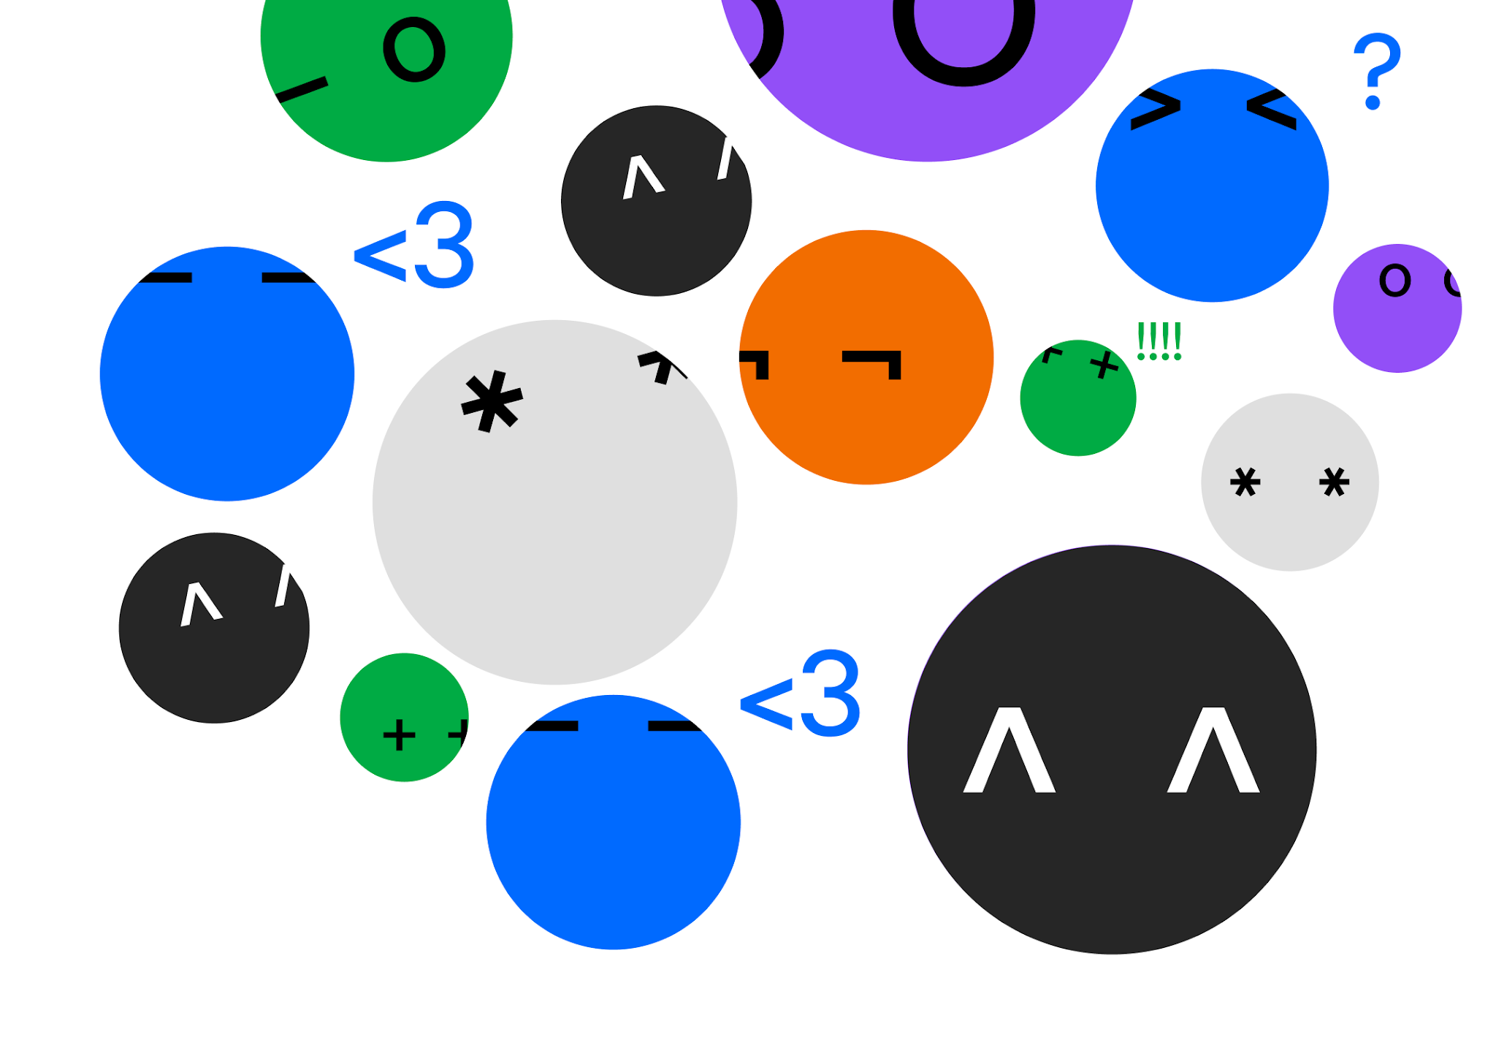
What will you build next?
All announcements
openai.com/index/devday-2026-recap
Developer guides
developers.openai.com
Product guides
learn.chatgpt.com
Notes:
What will you build next?
Visual reference: https://dotcom-design-engineering.openai.chatgpt.site/dev-day

